Slide 1
INVESTMENT ASSIGNMENT SUBMISSION
Name: Vinay Kumar Soni

Slide 2
Objective
Objective
Spark Funds wants to make investments in best sectors and contries where investors are already investing. For the purpose we need to understand the global trends in investments.
Data available
Investment analysis is to identify which company is better to invest. For the purpose we have 3 data files companies.txt, rounds2.csv and mapping.csv
Steps of analysis
Investment type need to identify we have to narrow down to 4 investment type venture, seed, angel, private equity, need to keep in mind investment amount bracket is 5 to 15 million USD
Countries need to analysis which are heavily invested and speaking English only
Sector analysis given 8 sectors need to find out which sector is invested more invested and to be invested,

Slide 3
Flow chart: Steps
Getting data
Downloaded CSV files from UpGrad website
companies.txt
rounds2.csv
mapping.csv
For merging data identified unique value,
Country analysis
Extracted top 9 countries as suggested in checkpoint
Ranked them as per investment in countries,
Sorted out 3 English speaking country accordingly
Mapping for sector analysis
Reading of mapping file and categorization checked
Prime sector selected
Melted data frame according to category list,
Map result was identification of 8 main sectors,
Data cleaning
Conversion of details to same case letters
Identification of missing value,
Trimming of data which are not required,
More data cleaning
Removal of null values removal of country code column pending,
Dropped Columns which we are not interested,
Sector wise investment analysis
Total no. of investment count calculation,
Investment in sector sum() to get total
Top sectors segregated based on count of investment
Best companies in sector receive maximum investment
Merging data frame
Merging of data frame companies and rounds2 which is master data frame for further analysis
Accumulated info about merge data frame
Funding type analysis
Average of funding by using groupby function,
Our interest was to invest where funding is between 5 to 15 million USD
Extracted “venture” type investment is fit for our investment
Plots as per checkpoint

Slide 4
Analysis : Understanding provided data
Loaded all necessary files and changed all letter in small
Data details understanding
Before merging we should know unique values
Compared both files can be merged so that data set not get much disturbed,
Merging of Data frames and created master data frame
Compared unique values equal in both data files companies and rounds2
Merged two data frames and got required data frame to work on

Slide 5
Analysis : Funding Type investment analysis
Analyzed and got concise mater frame data,
Calculated average amount of investment in given funding type
Average investments are mentioned below
Venture 11.9 Million USD
Angel 0.99 Million USD
Seed 0.76 Million USD
Private Equity 75.6 Million USD
According to data found Venture type funding is proper

Slide 6
Analysis : Country wise investment analysis
Funding type venture is suited for our analysis as it is in bracket of 5-15 million USD,
Retrieved from data top 9 countries heavily invested,
From Wikipedia identified top 3 English speaking country
We got USA,GBR,IND are countries where we need to invest
Analysis : Sector wise investment analysis
Sector to be analyzed to get which sector to be invested,
As data having many sectors mapped with provided file
Total number of investment were highest in USA followed by GBR and IND
Investment wise as well USA is on top followed by GBR and IND

Slide 7
Analysis : Sector wise investment analysis cont.
Main sectors invested for USA are Others, Cleantech/Semiconductors, Health
Main sectors invested for GBR are Others, Cleantech/Semiconductors, News, search and messaging
Main sectors invested for IND are Others, News, search and messaging , Health
Number of counts in top 3 sectors for USA are 1924,1606, 562
Number of counts in top 3 sectors for GBR are 101,95, 31
Number of counts in top 3 sectors for IND are 73,29, 22
Top sector company which received highest investment in USA are NantMobile, Stion
Top sector company which received highest investment in GBR are Tribold, Elixent
Top sector company which received highest investment in USA are ItzCash Card Ltd., Mobile2Win India

Slide 8
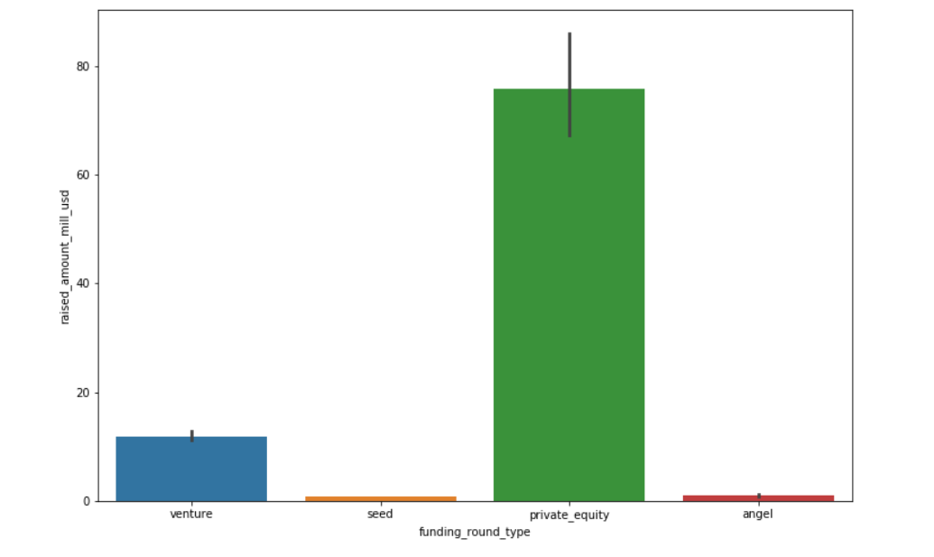
Plot: Total investments based on funding type with mean

Slide 9
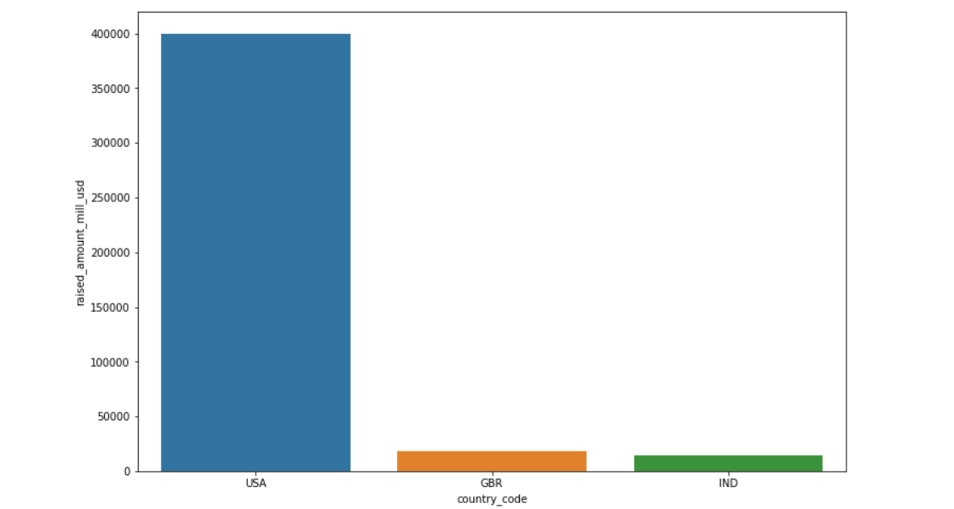
Plot:Top3 English speaking countries based on investment

Slide 10
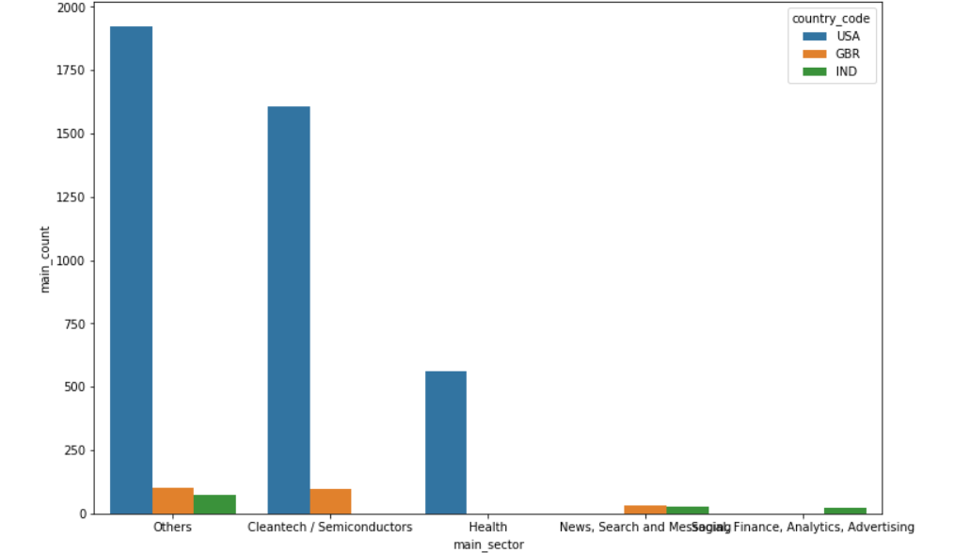
Plot: Top sectors having top3 countries based on counts

Slide 11
Conclusions
Based on analysis for Spark Funds we can conclude as below:
Spark Funds have to invest in Venture capital
Top3 English speaking countries where spark fund prefer to invest are
USA
Great Britain
India
The most suitable sectors for investment are
Others
Cleantech/Semiconductors
News, Search and Messaging

